Slide 1
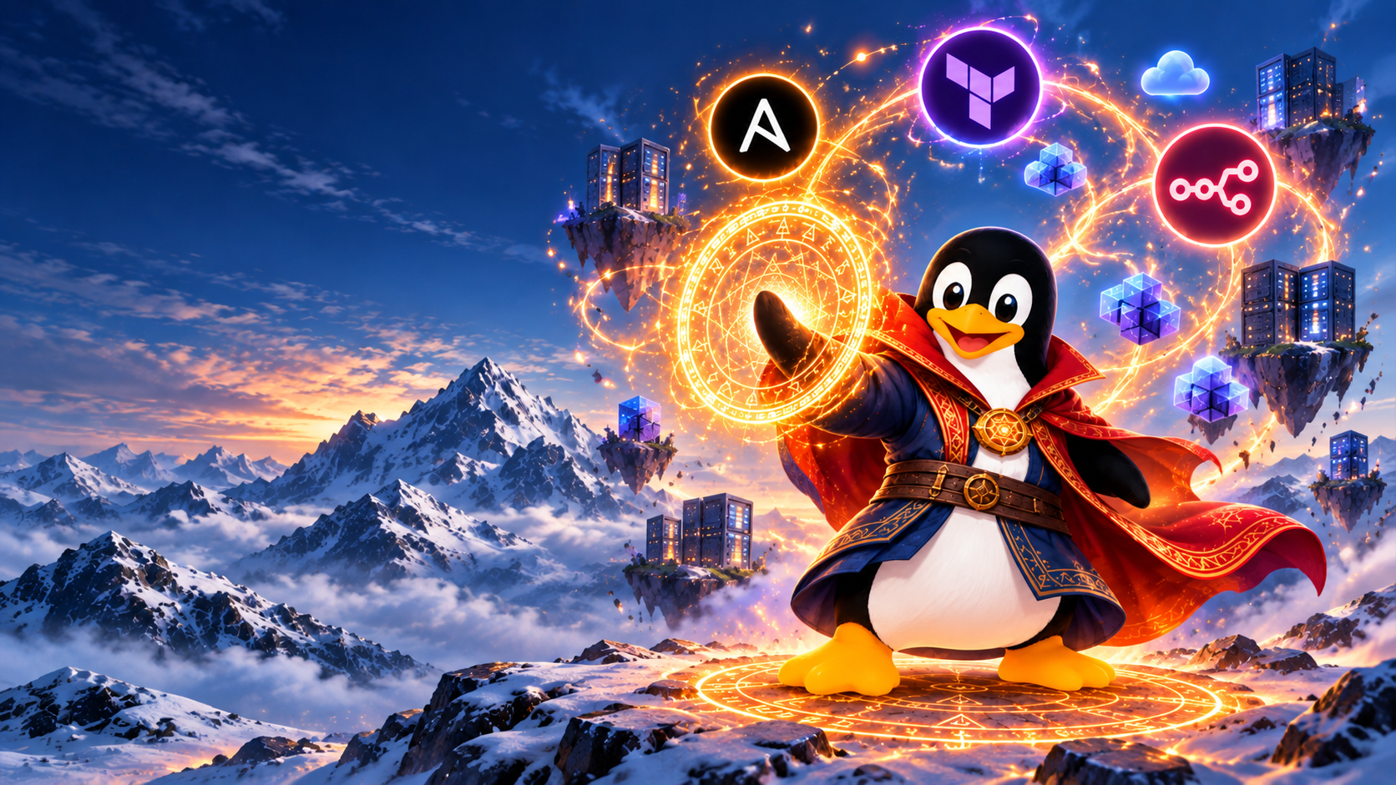
Automation
Without Borders
Farshad Nickfetrat
Notes:
برنامه پیشنهادی برای ۹۰ دقیقه: ۷۰ دقیقه ارائه و ۲۰ دقیقه پرسش. داستان‌ها۸دقیقه،تعریف وذهنیت ومثال‌شهر۸دقیقه،انقلاب‌صنعتی۳دقیقه،Bash/cron/CI/CD۶دقیقه،نقشه‌ابزارهاوتفاوت‌مفاهیم۸دقیقه،دموn8n۱۲دقیقه،هزینه۵دقیقه،مثالTerraform۶دقیقه،تست‌وگاردریل‌وبازیابی۸دقیقه،AIوجمع‌بندی۶دقیقه. دمو ابری زنده نیاز به rehearsal روی حساب دارد؛ آماده‌سازی اسلایدها تأیید اجرای موفق روی حساب نیست.
Suggested pacing: about 30 minutes of teaching plus a 10-minute live demonstration. By the end, students should distinguish scheduling, delivery pipelines, provisioning, and infrastructure as code.

Slide 2

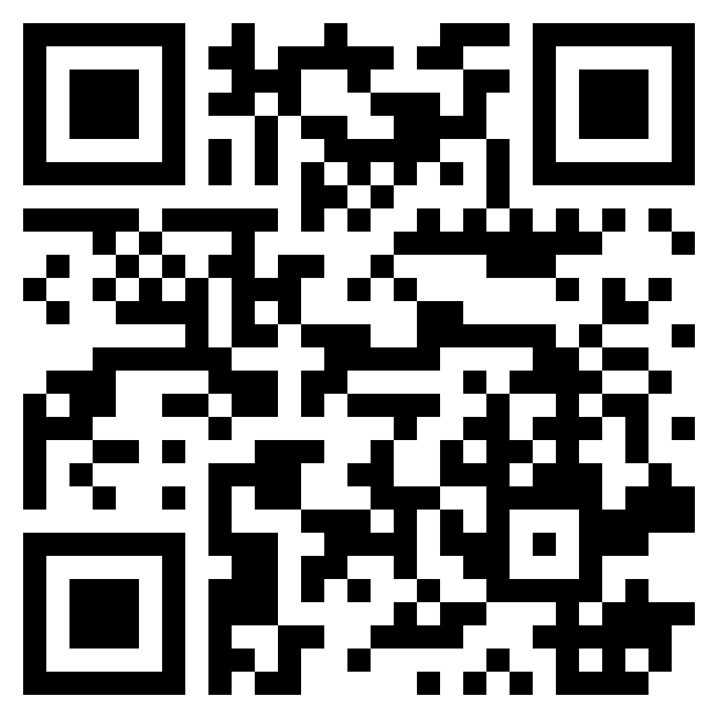
Who am I ?
Farshad Nickfetrat
CTO of Devops Iran
Founder of Packops.ir
Devops Team Lead At ADLAS
Devops Engineer Alibaba
Devops Engineer Zarinpal
Notes:
Merged supporting material:
GitLab: 31 January 2017
What happened?
GitLab experienced PostgreSQL database replication problems.
An engineer attempted to fix the issue by removing data from a secondary database.
By mistake, the engineer executed rm -rf on the primary production database.
Approximately 300 GB of production data was deleted.
Backup systems failed to provide a recent, reliable recovery point.
Impact
18 hours of service disruption
Approximately 6 hours of data permanently lost
Around 5,000 projects and 5,000 comments affected
Root causes
Human error during manual operations
Insufficient safeguards against destructive commands
Unreliable and untested backup procedures
Lack of automated recovery validation
Key lesson for automation:
One wrong command caused the incident, but missing safeguards and unreliable backups turned it into a disaster.
Official report: GitLab Incident Postmortem

Slide 3
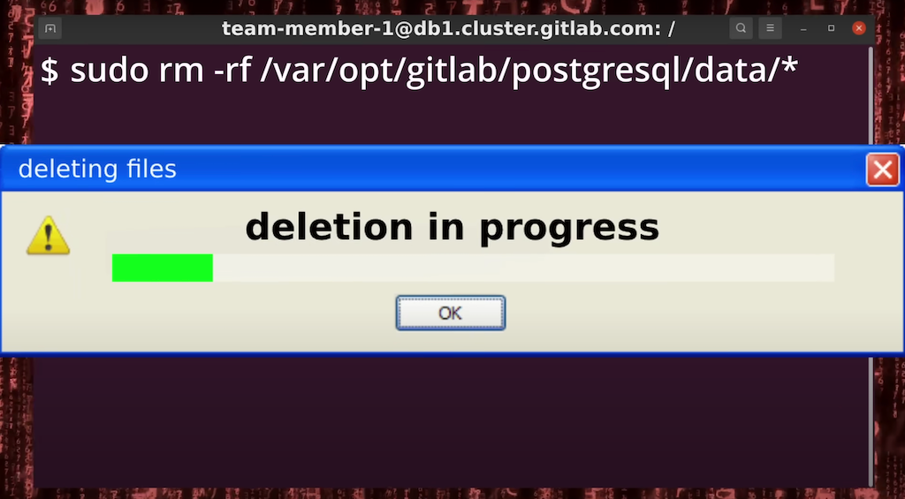
GitLab 31 January 2017
Notes:
Merged supporting material:
GitLab: 31 January 2017
What happened?
GitLab experienced PostgreSQL database replication problems.
An engineer attempted to fix the issue by removing data from a secondary database.
By mistake, the engineer executed rm -rf on the primary production database.
Approximately 300 GB of production data was deleted.
Backup systems failed to provide a recent, reliable recovery point.
Impact
18 hours of service disruption
Approximately 6 hours of data permanently lost
Around 5,000 projects and 5,000 comments affected
Root causes
Human error during manual operations
Insufficient safeguards against destructive commands
Unreliable and untested backup procedures
Lack of automated recovery validation
Key lesson for automation:
One wrong command caused the incident, but missing safeguards and unreliable backups turned it into a disaster.
Official report: GitLab Incident Postmortem

Slide 4
GitLab: the wrong database server
db1 · PRIMARY
rm -rf [data directory]
^C
Ctrl
+
C
db1 · PRIMARY
Stopped after noticing the mistake

Slide 5
GitLab: the scale of the deletion
PRIMARY DATABASE
~300 GB
before deletion
~4.5 GB
remaining when the command stopped
~300 GB removed

Slide 6
GitLab: estimated data loss
GitLab’s estimate of affected database records
~5,000
~5,000
~700
PROJECTS
COMMENTS
NEW USERS
Project data
Comments
New user accounts
Git repositories and wikis did not lose their code.

Slide 7

Knight Capital 1 August 2012
How one failed deployment cost a company
$460 million in just 45 minutes.
$460M
Trading Loss
45 min
Incident Duration
1 of 8
Servers Not Updated
Notes:
Merged supporting material:
Knight Capital: 45 minutes of erroneous trading
7 OF 8 SERVERS
OLD CODE
$460M LOSS
Automated trading amplified the deployment error.
A reused flag activated obsolete Power Peg logic.
A manual release missed one trading server.
Open with the story before introducing the topic. A technician missed one of eight servers during deployment. Legacy code responded to the new flag. The trading system rapidly built unwanted positions. The SEC reports a $460 million realized loss, while early reporting often used $440 million. Lesson: use verified deployment automation with risk limits. These are proposed controls, not proof that any one tool would have prevented the incident.
Source: https://www.sec.gov/litigation/admin/2013/34-70694.pdf

Slide 8



Pillars of Enterprise Automation
Transforming manual operations into scalable, deterministic systems
speed
Velocity
10x Faster
Accelerate release frequency and eliminate operational bottlenecks through continuous integration.
verified_user
Reliability
99.99% Ops
Enforce immutable infrastructure and deterministic configurations to prevent system drift.
security
Governance
Zero Trust
Automate compliance guardrails, vulnerability scanning, and audit trails by default.
Notes:
تعریف: اجرای یک فرایند مشخص با کمترین تکرار دستی. همه اتومیشن‌ها زمان‌بندی‌شده نیستند. خروجی باید قابل سنجش باشد. پلی برای ذهنیت: قبل از انتخاب ابزار، فرایند و معیار موفقیت را روشن کنیم.
Provisioning is one category of work that automation can perform. Creating a VM is provisioning. Installing a web server is configuration. A provisioner is a mechanism or tool that carries out setup. Bash can automate all of these, but it does not automatically provide desired-state management.

Slide 9
The automation mindset
Automate the repetitive Focus on the innovative
Notes:
Ask students what failed in each story. Knight combined a manual deployment gap with rapid automated execution. GitLab combined a destructive manual action with broken backup automation. The common problem was missing controls around operations. Avoid claiming that automation alone guarantees safety.

Slide 10



“Give me six hours to chop down a tree, and I will spend the first four sharpening the axe.”
Attributed to Abraham Lincoln

Slide 11
Automation needs verification and tested recovery.
Notes:
Ask students what failed in each story. Knight combined a manual deployment gap with rapid automated execution. GitLab combined a destructive manual action with broken backup automation. The common problem was missing controls around operations. Avoid claiming that automation alone guarantees safety.

Slide 12



When NOT to Automate
Automation isn't a silver bullet — avoid forcing it in these critical scenarios.
UNSTABLE PROCESSES
ONE-OFF / LOW VOLUME
HIGH-JUDGMENT TASKS
If the workflow changes frequently, automating creates maintenance overhead rather than efficiency.
Tasks done rarely take more effort to automate and test than executing them manually.
Processes requiring human empathy, creative judgment, or nuanced decision-making under uncertainty.

Slide 13
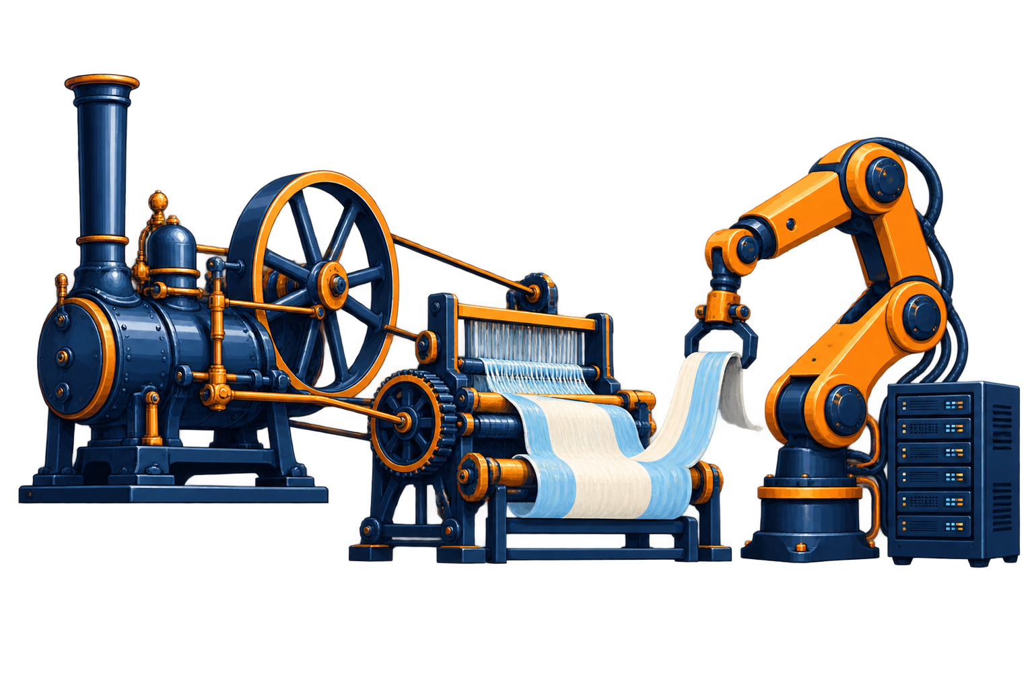
A brief history of automation
MECHANIZATION
Steam engines power industrial machinery.
FACTORY CONTROL
Electrical controls and computers coordinate production.
SOFTWARE
Programs repeat digital operations.
Notes:
Merged supporting material:
Machines
changed
human work
Bridge from today's incidents to industrial history. Machines replaced or reduced particular manual tasks and changed the work people performed. Mechanization is machine-powered work. Automation adds control over execution. Human responsibility moves toward design, maintenance, and exception handling.
Steam-powered machinery helped reshape industrial production. Later factory control systems added feedback and automated sequencing. Software extended this idea to digital operations. This is a conceptual history, not a claim that each phase replaced the previous one.
Source: https://blog.sciencemuseum.org.uk/steaming-through-the-centuries/

Slide 14

How Automation Starts
Start with one repeatable task.
Make the inputs explicit.
Check the result and failure path.

Slide 15
Bash scripts: repeatable commands
COMMANDS
A script records the steps of an operation.
INPUTS
Arguments replace hardcoded hosts and paths.
FAILURES
Exit checks stop later steps after an error.
Notes:
Show a short non-destructive example in a terminal: a script accepts an output directory, creates it, and writes a timestamp. Explain quoting variables and checking prerequisites. Scripts are procedural: they describe steps. Rerunning a script is safe only when its actions support it.

Slide 16
Cron jobs: scheduled execution
SCHEDULE
Cron runs a command at a chosen time.
EXECUTION
The script still needs safe inputs and error handling.
MONITORING
Alerts must report failed or missing runs.
Notes:
Example: 0 2 * * * /opt/ops/backup.sh runs at 02:00 in the scheduler's configured timezone. Cron answers when to run, not whether a backup is usable. Connect this directly to GitLab. Include locking for overlapping jobs and test restores separately.

Slide 17
CI/CD: changes trigger a workflow
COMMIT
A Git change triggers the pipeline.
CHECKS
Tests and policy checks validate the proposed change.
RELEASE
Deployment follows the team's approval rules.
Notes:
Continuous integration checks changes frequently. Continuous delivery keeps a change ready for release, often with approval. Continuous deployment automatically releases changes that pass checks. These tools can coexist with Bash and cron. They are not a strict historical replacement sequence. Example flow: commit, build, test, approval, deployment, health check.

Slide 18
Every change goes through the automation pipeline.
No direct manual changes to managed environments.
Notes:
سیاست این تیم: تغییر مستقیم دستی روی محیط مدیریت‌شده نداریم. انسان تغییر را پیشنهاد و review می‌کند، اما اجرای تغییر فقط از مسیر اتومیشن انجام می‌شود. تغییرات تنظیمات، deployment،provisioning و cleanup باید در همان مسیر قابل‌ردیابی باشند. این اسلاید دقیقاً بعد CI/CD قرار می‌گیرد.
Ask students what failed in each story. Knight combined a manual deployment gap with rapid automated execution. GitLab combined a destructive manual action with broken backup automation. The common problem was missing controls around operations. Avoid claiming that automation alone guarantees safety.

Slide 19
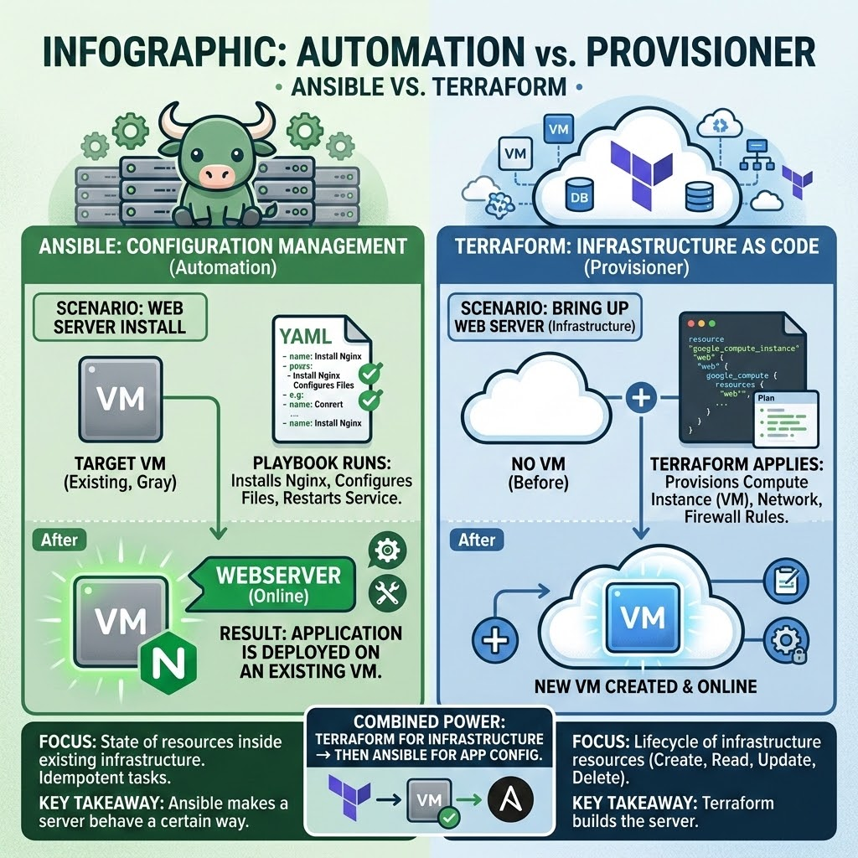
Automation and provisioning
Provisioning creates resources. Configuration prepares them.
Both can be automated.
Notes:
Merged supporting material:
Automation and provisioning
AUTOMATION
PROVISIONING
CONFIGURATION
Configuration prepares a machine to run its workload.
Provisioning creates or allocates infrastructure.
Automation runs tasks with less manual repetition.
Provisioning is one category of work that automation can perform. Creating a VM is provisioning. Installing a web server is configuration. A provisioner is a mechanism or tool that carries out setup. Bash can automate all of these, but it does not automatically provide desired-state management.

Slide 20






Automation tools by primary role
Automation is the umbrella. These roles overlap.
PROVISIONING
CONFIGURATION
WORKFLOWS
LIFECYCLE / PATCH
Ansible
Puppet
Terraform
n8n
Foreman
Chef
+ Katello
Create cloud resources
Connect events and API actions
Content and package updates
Foreman also provisions hosts and integrates with configuration tools.
Notes:
دسته‌بندی بر اساس کاربرد اصلی است و دسته‌ها انحصاری نیستند. Foreman یک ابزار چرخه عمر است که provisioning،پارامترها و گزارش‌های configuration را هم پوشش می‌دهد. Katello مدیریت repository، content view و package/errata updates را اضافه می‌کند. اتومیشن چتر همه این‌هاست. لوگوها از Simple Icons و سایت رسمی Foreman دریافت شده‌اند.
Sources: https://theforeman.org/ ; https://theforeman.org/plugins/katello/ ; https://simpleicons.org/
Merged supporting material:
Automation tools solve different problems
BASH
ANSIBLE
CI/CD
Pipelines check and deliver changes from Git.
Playbooks configure and maintain machines.
Scripts execute a sequence of commands.
این ترتیب یک مسیر یادگیری است، نه این ادعا که DevOps تاریخی فقط با Bash شروع شد. Bash، cron، Ansible، CI/CD، Terraform و n8n می‌توانند هم‌زمان استفاده شوند. Terraform زیرساخت می‌سازد؛ n8n زمان و رویداد را به فراخوانی API وصل می‌کند.
Provisioning is one category of work that automation can perform. Creating a VM is provisioning. Installing a web server is configuration. A provisioner is a mechanism or tool that carries out setup. Bash can automate all of these, but it does not automatically provide desired-state management.

Slide 21
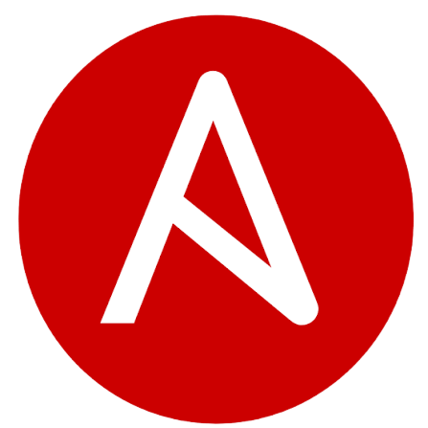
Ansible & Automation Benefits
Agentless
Idempotent
Human-Readable
Speed & Scale
Connect through SSH or WinRM without an Ansible agent.
Use suitable modules to keep reruns from making unnecessary changes.
YAML playbooks document the configuration you want.
Apply consistent configuration across many hosts with less manual repetition.

Slide 22

Terraform & Provisioning Benefits
Declarative IaC
State Management
Multi-Cloud
Execution Plan
Describe resources. Terraform determines their dependencies and proposed changes.
State maps configuration to managed resources.
Providers connect the same workflow to different cloud APIs.
Review proposed creations, updates and deletions before applying.

Slide 23
Infrastructure as Code
DECLARATION
STATE
PLAN
Code describes the infrastructure you want.
State links resource definitions to managed objects.
The plan previews proposed infrastructure changes.
Notes:
Merged supporting material:
Infrastructure as Code
Describe infrastructure in versioned code.
Review the plan before creating or changing resources.
Desired-state tools calculate changes from configuration and observed resources. State must be protected and shared safely for team use. A plan can include creations, updates, or deletions. IaC does not guarantee identical runtime behavior when images, external dependencies, or configuration change.
Source: https://developer.hashicorp.com/terraform/cli/commands/plan

Slide 24
Provisioners in Terraform
PROVIDER
RESOURCE
PROVISIONER
A provider connects Terraform to an API.
A resource describes a managed object such as a VM.
A provisioner runs extra commands after resource operations.
Notes:
Clarify the similar words. An Arvan provider uses the cloud API. An arvan_iaas_abrak resource describes the VM. Terraform provisioners such as remote-exec or local-exec perform imperative steps. HashiCorp recommends exhausting alternatives such as machine images and configuration management because Terraform cannot predictably model provisioner behavior. Prefer cloud initialization or images when supported.
Source: https://developer.hashicorp.com/terraform/language/provisioners

Slide 25
IaC in the delivery pipeline
GIT REVIEW
POLICY CHECKS
APPROVED PLAN
Infrastructure changes have a reviewable history.
Checks enforce limits on cost and access.
The pipeline applies the reviewed plan and verifies results.
Notes:
Example workflow: pull request, validation, plan, policy check, approval, apply, verification. Store state securely, serialize writes, and detect drift. Keep credentials outside the repository. A plan is a proposed action, not a complete safety guarantee.

Slide 26
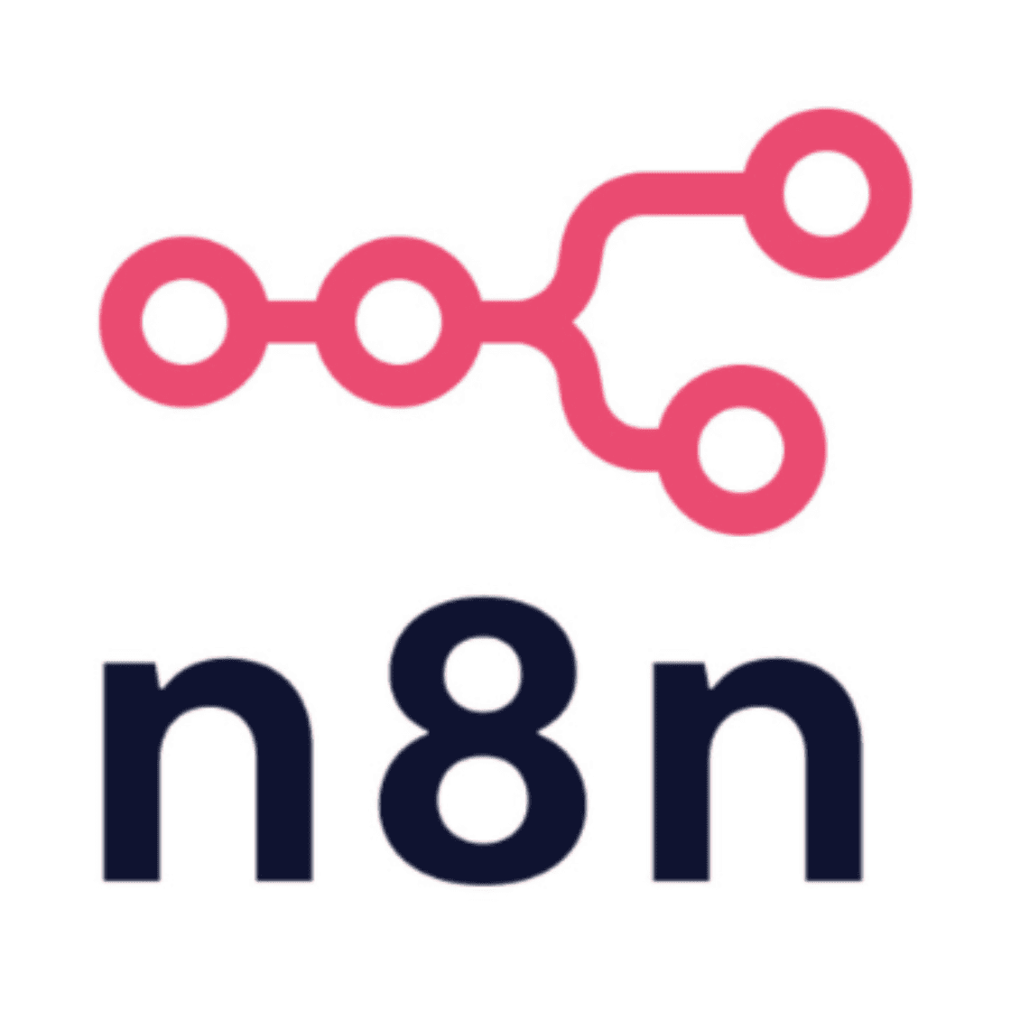
n8n: Workflow Automation Platform
Node-Based Workflows
Hosting & Access
Custom Logic
Role in Stack
Connect triggers, rules and API calls as a visual workflow.
Choose cloud hosting or self-hosting, then configure access and security.
Extend workflows with code and supported integrations.
Orchestrate when configuration and provisioning tasks should run.
Notes:
Security depends on your deployment configuration; self-hosting alone does not guarantee security. Prepare, test and authenticate the API connection before the presentation.
Sources: https://docs.n8n.io/integrations/builtin/core-nodes/n8n-nodes-base.httprequest/

Slide 27
n8n demo: the classroom lab
SCHEDULE
BOUNDARIES
FIRST RUN
Thursday and Friday, 13:00 to 17:00 Tehran time.
One approved VM for the PackOps sandbox.
A manual dry run shows the proposed action first.
Notes:
هدف دمو: orchestration چرخه عمر لابراتوار، نه صرفاً خاموش کردن ماشین. زمان چهار ساعت ۱۳ تا ۱۷ از پایان ساعت۱۷ و طول جلسه۴ساعت استنباط شده. workflow timezone را Asia/Tehran تنظیم کن. Schedule Trigger را پس از تست ذخیره و publish کن. ابتدا Manual Trigger و ورودی mock استفاده شود؛ بدون حساب آماده ادعای اجرای زنده نکن.
Source: https://docs.n8n.io/integrations/builtin/core-nodes/n8n-nodes-base.scheduletrigger/
Provisioning is one category of work that automation can perform. Creating a VM is provisioning. Installing a web server is configuration. A provisioner is a mechanism or tool that carries out setup. Bash can automate all of these, but it does not automatically provide desired-state management.

Slide 28
n8n: the lab opening workflow
1
2
3
4
5
TRIGGER
READ INPUTS
CHECK RULES
CREATE / REUSE
VERIFY
Class day at 13:00
Course, region and size
Sandbox and budget
Call the cloud API
Confirm VM is ready
One course. One sandbox VM. An observable result.
Notes:
در canvas: Schedule Trigger، Edit Fields، IF، HTTP Request، سپس بررسی وضعیت. مسیر False از IF به گزارش عدم اجرا می‌رود. ورودی شامل course_id، approved region، size و یک resource count است. قبل ساخت، VM دوره را جست‌وجو کن؛ اگر همان VM وجود دارد دوباره نساز. credential در تنظیمات محرمانه node باشد. endpoint و payload را از API فعلی حساب تأیید کن؛ در این deck endpoint حدس زده نشده است.
Sources: https://docs.n8n.io/integrations/builtin/core-nodes/n8n-nodes-base.scheduletrigger/
https://docs.n8n.io/integrations/builtin/core-nodes/n8n-nodes-base.httprequest/

Slide 29
n8n: the 17:00 lab closing workflow
1
2
3
4
5
TRIGGER
SELECT LAB
SAVE WORK
RELEASE
CONFIRM
Class day at 17:00
Match course and owner
Confirm export is ready
Release approved resources
Audit remaining costs
Saved student work comes before releasing resources.
Notes:
Workflow دوم ساعت۱۷ فقط منابع همان کلاس را هدف می‌گیرد. Guardrail باید شناسه و محیط را بررسی کند. خروجی یا داده دانشجو قبل release ذخیره شود؛ اگر داده تأیید نشده، متوقف و به مسئول گزارش شود. Stop منابع را رزرو نگه می‌دارد. Terminate هزینه دیسک و IP را باقی می‌گذارد. حذف یا آزادسازی دقیق باید با API و طرح فعلی حساب آزمایش شود. این نمودار صرفاً دمو و طرح اجراست و هیچ منبع واقعی را حذف نمی‌کند.
Sources: https://www.arvancloud.ir/fa/pricing/cloud-server
https://docs.n8n.io/integrations/builtin/core-nodes/n8n-nodes-base.httprequest/

Slide 30
Live demo: prove the workflow is safe
Test input | Expected outcome
Approved sandbox, one VM | Preview one allowed operation
Production target | Reject before the API request
Repeat the same request | Reuse the lab instead of duplicating it
API failure or missing saved work | Stop, record the failure and alert
First demonstrate with simulated responses and no cloud writes.
Notes:
دمو پیشنهادی ۱۰ تا ۱۲ دقیقه: ابتدا workflow را دستی اجرا کن و خروجی proposed operation را نشان بده. dry_run=true در IF باید مسیر نوشتن را مسدود کند؛ آن را صرفاً در HTTP header نگذار. خروجی mock را با متن simulated مشخص کن. مورد production باید رد شود. rerun باید تعداد VM را زیاد نکند. پاسخ خطای API باید به شاخه failure برسد. سپس تنها در حساب آزمایش‌شده عملیات واقعی تأییدشده را اجرا کن. نشان‌دادن مسیر خطا از صرف موفقیت مهم‌تر است.

Slide 31
170 hours across about five months
170 hours
21 weeks + 2 hours
Day | Lab time | At 17:00
Thursday | 13:00–17:00 · 4 h | End lab and release resources
Friday | 13:00–17:00 · 4 h | End lab and release resources
21 full weeks × 8 h = 168 h. Final session: 2 h in week 22.
If every session stays 4 h, provision for 172 h instead: 3,261,808 toman.
Notes:
برنامه نمونه هر پنجشنبه و جمعه ساعت ۱۳ تا ۱۷ به وقت محلی است. ساعت شروع ۱۳ از چهار ساعت کلاس و پایان ۱۷ استنباط شده است. ۲۱ هفته × ۸ ساعت = ۱۶۸ ساعت. جلسه پایانی دوساعته در پنجشنبه هفته ۲۲ انجام می‌شود. بدون تاریخ شروع نمی‌توان تاریخ تقویمی پایان را تعیین کرد. پنج ماه یک فرض برآوردی برای اجاره است. اگر جلسه آخر هم چهار ساعت رزرو شود، ۱۷۲ ساعت VM × ۱۸٬۹۶۴ = ۳٬۲۶۱٬۸۰۸ تومان، قبل از هزینه‌های جانبی.

Slide 32
Cost of the full 170-hour course
Thursday + Friday: 4 hours each day. Five billed months assumed.
Option | Calculation | Estimated cost (toman)
Dedicated server | 5 × 12,840,000 | 64,200,000
VM during labs | 170 × 18,964 | 3,223,880
Base saving | 64,200,000 − 3,223,880 | 60,976,120 · 95.0%
Actual VM total = 3,223,880 + retained-resource and other charges.
Prices supplied for this example. Final rental months depend on course dates.
Notes:
Merged supporting material:
How the workflow reduces lab costs
CLASS HOURS
RESOURCE LIFETIME
BILLING CHECK
Compare the bill with runtime and retained resources.
Release resources that the class no longer needs.
Provision for the scheduled teaching window.
بین دمو و جدول هزینه پل بزن: خود n8n نرخ سرور را کم نمی‌کند. فرایندی اجرا می‌کند که طول عمر منابع را با نیاز کلاس هماهنگ می‌کند. حدود۱۷۰ساعت کلاس در۲۲هفته انجام می‌شود. اختلاف مالی پایه با فرض۵دوره اجاره محاسبه شده است؛ مبلغ واقعی شامل دیسک،IP،ترافیک،زمان آماده‌سازی، ابزار orchestration و هرمنبع نگه‌داری‌شده می‌شود.
Provisioning is one category of work that automation can perform. Creating a VM is provisioning. Installing a web server is configuration. A provisioner is a mechanism or tool that carries out setup. Bash can automate all of these, but it does not automatically provide desired-state management.
برای دوره ۱۷۰ ساعته، با هفته‌ای ۸ ساعت، ۲۱ هفته کامل و یک جلسه دوساعته در هفته ۲۲ لازم است. اگر همه جلسات چهار ساعته باشند، زمان رزرو VM برابر ۱۷۲ ساعت می‌شود. مثال مالی با فرض پنج دوره صورتحساب ماهانه برای ددیکیت است؛ تعداد واقعی صورتحساب به تاریخ شروع و پایان و قرارداد اجاره بستگی دارد. نرخ‌های مالی را کاربر داده است؛ نرخ ضمنی VM برابر ۱۸٬۹۶۴ تومان در ساعت است. ۵×۱۲٬۸۴۰٬۰۰۰ = ۶۴٬۲۰۰٬۰۰۰ تومان. ۱۷۰×۱۸٬۹۶۴ = ۳٬۲۲۳٬۸۸۰ تومان. اختلاف پایه ۶۰٬۹۷۶٬۱۲۰ تومان، برابر ۹۴٫۹۸٪ است. این صرفه‌جویی قبل از اضافه کردن هزینه‌های نگه‌داری منابع، IP، دیسک، ترافیک یا زمان آماده‌سازی است و هزینه نهایی سناریوی Stop نیست.

Slide 33
17:00 shutdown: which costs actually stop?
Stop keeps resources reserved and billable.
Action after class | Billing consequence
Stop | CPU, RAM and disk remain reserved and charged.
Terminate | Disk and IP charges remain.
Release unused resources | Remaining charges depend on what you retain.
Before class: provision. After class: save lab work, then release unused resources.
Source: ArvanCloud Cloud Server pricing FAQ · checked 14 Oct 2026
Notes:
طبق پرسش‌های رایج رسمی آروان، Stop همه منابع انتخابی را رزرو و صورتحساب آنها را ادامه می‌دهد. Terminate هزینه دیسک و IP را باقی می‌گذارد. برای نزدیک شدن به هزینه ساعات لابراتوار، قبل کلاس محیط را با IaC ایجاد کنید و پس از ذخیره خروجی و داده دانشجویان، منابعی را که نیاز ندارید آزاد کنید. این اسلاید صرفاً توضیح جریان کار است و هیچ منبع واقعی را حذف نمی‌کند. مبلغ دقیق هزینه‌های باقی‌مانده به انتخاب منابع و طرح حساب وابسته است.
Source: https://www.arvancloud.ir/fa/pricing/cloud-server
Checked: 14 October 2026

Slide 34
ArvanCloud demo setup
ACCOUNT
VM INPUTS
PREFLIGHT
A sandbox account supplies the API key and quota.
Choose a current region, flavor, image, and SSH key.
Rehearse the provider against the account before class.
Notes:
Merged supporting material:
Live demo:
An ArvanCloud VM
Switch to the prepared lab directory. The goal is one Abrak VM in a student sandbox. This presentation does not create cloud resources. Run the lab only using your own authorized account and budget.
Use the published arvancloud/arvan provider pinned to 0.6.4 for the accompanying teaching example. The repository is archived. Check current API compatibility and available region, size, and image identifiers before demonstrating. Supply the API key through a private environment variable. Do not project credentials or use production state.
Sources: https://registry.terraform.io/providers/arvancloud/arvan/latest/docs
https://github.com/arvancloud/terraform-provider-arvan

Slide 35

Guardrails and tests

Slide 36
Guardrails for cloud actions
SCOPE
LIMITS
APPROVAL
Allow only this course and its sandbox resources.
Restrict VM count, size and total running hours.
Require review for destructive or unexpected changes.
Notes:
گاردریل باید قبل فراخوانی API enforce شود. منابع production ممنوع، حداکثر۱VM، region و size از allowlist، ساعت ومالک مشخص. اگر حساب به credentials حساس دسترسی دارد، آن را در canvas یا log به نمایش نگذار. قواعد را بیرون از اختیار AI agent enforce کن. تست نشان می‌دهد رفتار درست است؛ گاردریل جلوی رفتار خارج از سیاست را می‌گیرد.
Provisioning is one category of work that automation can perform. Creating a VM is provisioning. Installing a web server is configuration. A provisioner is a mechanism or tool that carries out setup. Bash can automate all of these, but it does not automatically provide desired-state management.

Slide 37
Failure handling and recovery
STOP
REPORT
RECOVER
Stop later steps when an operation fails.
Log the target and error, then notify the owner.
Use a tested recovery plan before retrying writes.
Notes:
Error workflow در n8n از Error Trigger شروع می‌شود و می‌تواند اطلاعات اجرای شکست‌خورده را به مسیر هشدار ببرد. retry کور برای عملیات ساخت VM ممکن است منابع تکراری بسازد؛ اول وضعیت مقصد بررسی شود. timeout،rate limit،credentials expired،missed schedule و failure بعد create را در rehearsal ببین. snapshot یا rollback هم باید قبلاً آزموده شود.
Source: https://docs.n8n.io/flow-logic/error-handling/
Provisioning is one category of work that automation can perform. Creating a VM is provisioning. Installing a web server is configuration. A provisioner is a mechanism or tool that carries out setup. Bash can automate all of these, but it does not automatically provide desired-state management.

Slide 38
AI agents
and Automation
Notes:
Introduce a future direction: agents can translate intent into proposed infrastructure changes. Present this as a workflow design, not a prediction that all teams should grant agents autonomous cloud access.

Slide 39
AI agents with guardrails
PROPOSE
CONSTRAIN
APPROVE
The agent drafts a change and explains the plan.
Policy limits regions, VM sizes, access, and resource count.
A human approves the exact plan before controlled execution.
Notes:
Suggested architecture: intent, agent-generated pull request, validation and plan, independent policy enforcement, human approval, restricted executor, verification and audit log. Keep secret access and enforcement outside the agent's discretion. Reject public administrative ports, production deletion, oversized instances, and unexpected resource counts. Stop on failed checks or uncertain results. Log changes and prepare recovery.

Slide 40

IAC and AI agent
Notes:
Suggested architecture: intent, agent-generated pull request, validation and plan, independent policy enforcement, human approval, restricted executor, verification and audit log. Keep secret access and enforcement outside the agent's discretion. Reject public administrative ports, production deletion, oversized instances, and unexpected resource counts. Stop on failed checks or uncertain results. Log changes and prepare recovery.

Slide 41
Reliable automation makes the safe process repeatable.
Notes:
Close the loop with the opening stories: verify deployment consistency, monitor jobs, test recovery, and review infrastructure changes. Ask students: which guardrail would have caught each failure, and where would you enforce it in the ArvanCloud workflow?

Slide 42
Thank You !!
Let automation handle repetition, so people can focus on better decisions.

